Slide 1
CSS Extension for Round Displays @ Web Developers Meetup in Google Sydney
Jihye Hong
(jh.hong@lge.com)
Software Platform Lab., LG Electronics

Slide 2
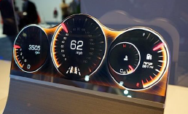
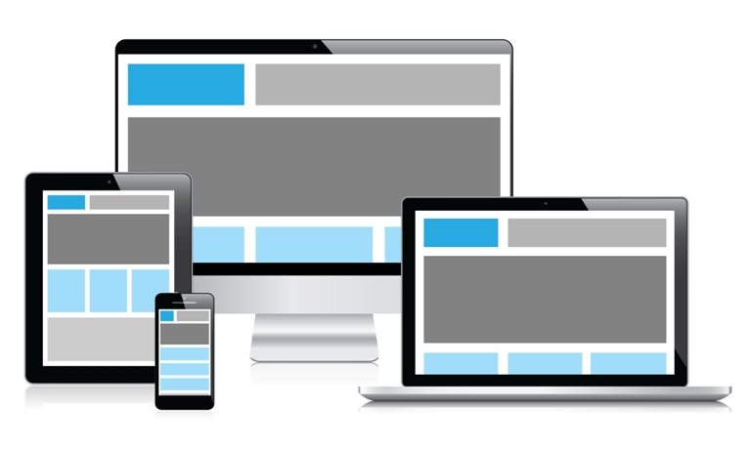
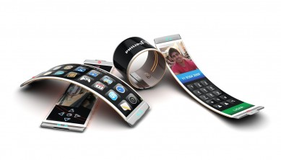
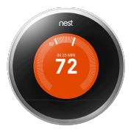
Background
Common web pages are in the rectangular screens
Web Platforms in various shapes of display
Wearable, Flexible, Bended …

Slide 3
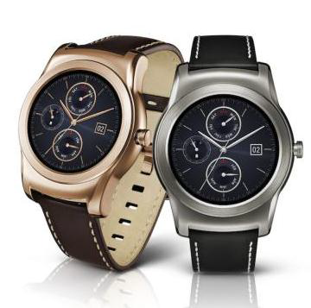
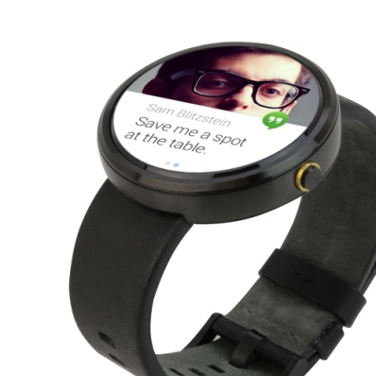
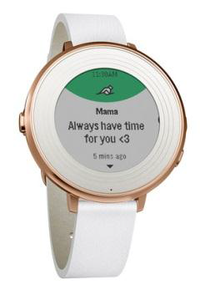
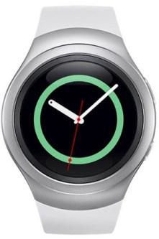
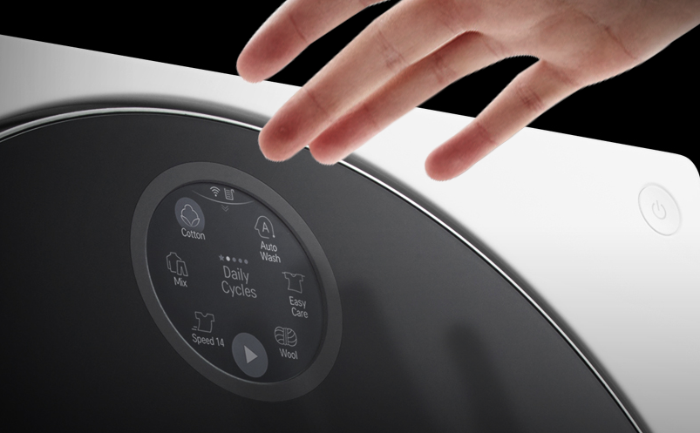
Background
Round display is natural for Smart watches
How can CSS do for the Round display?
LG Watch Urbane LTE
Samsung Gear S2
Moto 360
Pebble Time Round
webOS Tizen Android ??
LG signature: 세탁기 – 원형 디스플레이

Slide 4
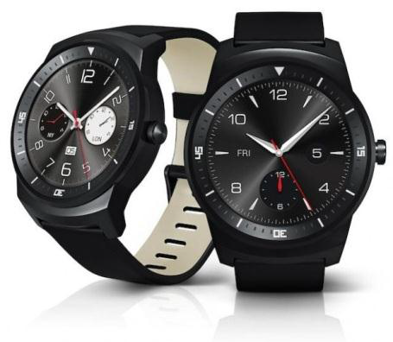

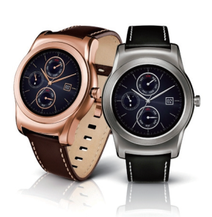
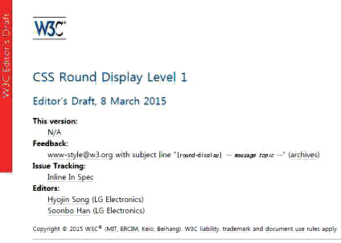
History
Sept, 2014
IFA 2014 ｜ Berlin
LG G Watch R at IFA 2014
Oct, 2014
TPAC 2014 Breakout Session ｜ Santa Clara
Introducing CSS Extensions for a Round Display
Feb, 2015
MWC 2015｜ Barcelona
LG Watch Urbane LTE
Feb, 2015
CSS WG F2F Meeting｜ Sydney
Editor’s Draft of CSS Round Display

Slide 5
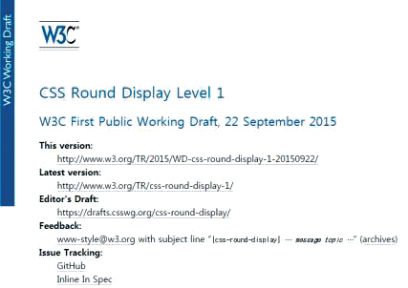


History
Aug, 2015
CSS WG F2F Meeting｜ Paris
First Public Working Draft of CSS Round Display
Oct, 2015
TPAC 2015 W3C Developer Meetup ｜ Sapporo
Introducing the last version of CSS Round Display

Slide 6
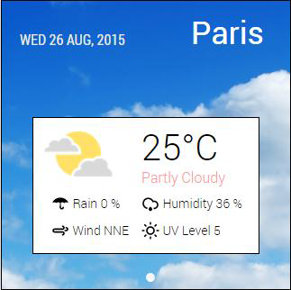
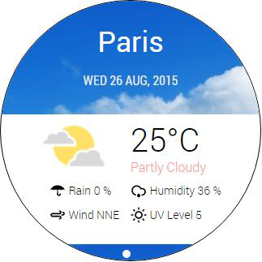
Detecting a round screen (Media Query)
Media Queries enables authors to apply different styles.
Add a new media feature device-radius (Inspired by border-radius)
Coverage: Rectangle with rounded corners, Circle, Ellipse, Diamond, ...
[1]
[2]
[1]: <link media="screen and (device-radius: 0%)" rel="stylesheet" href="rectangle.css”/>
[2]: <link media="screen and (device-radius: 50%)" rel="stylesheet " href="round.css”/>

Slide 7
Aligning content in the shape of device
Extend shape-inside property
Add display as a new value
ABCDEF
GHIJKLM
NOPQRS TUVWXY
ABCD EFGHIJK LMNOPQ RSTUV
shape-inside: circle (50% at 50%, 50%);
shape-inside: display;
?
shape-inside: display;
ABCDEFGHIJ
ABCDEFG HIJ

Slide 8
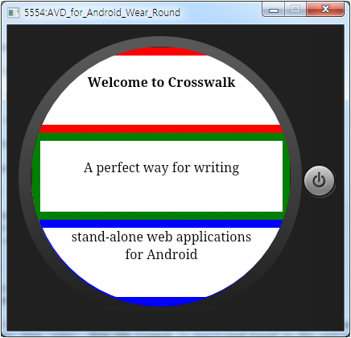
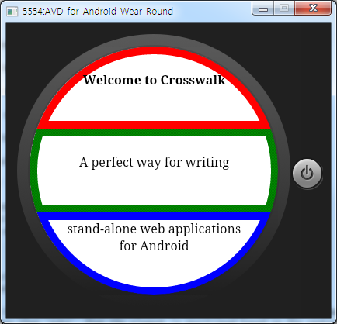
Drawing borders along the display edge
border-boundary
Value: none(default) | parent | display
border-boundary: none;
border-boundary: display;

Slide 9
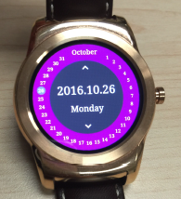
Polar Coordinates
polar-distance
non-auto value activates polar positioning
distance between the origin of polar coordinates and the anchor point of the element
contain: avoiding overflow
polar-angle
angle from the Y-axis
<div id=“container” >
<div id=“red” style=“position: absolute; polar-angle: 0deg; polar-distance: 50%”></div>
<div id=“green” style=“position: absolute; polar-angle: 90deg; polar-distance: 100%”></div>
<div id=“blue” style=“position: absolute; polar-angle: 225deg; polar-distance: 100% contain”></div>
</body>

Slide 10
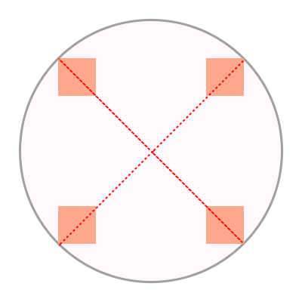
Origin Point and Anchor Point
polar-origin
Origin of polar coordinates
polar-anchor
A representative point of the element
<div id=“container” style=“position: absolute”>
<div id=“item1” style=“polar-angle: 45deg; polar-distance: 100%; polar-anchor: right top;”></div>
<div id=“item2” style=“polar-angle: 135deg; polar-distance: 100% polar-anchor: right bottom;”></div>
<div id=“item3” style=“polar-angle: 225deg; polar-distance: 100% polar-anchor: left bottom;”></div>
<div id=“item3” style=“polar-angle: 315deg; polar-distance: 100% polar-anchor: left top;”></div>
</body>

Slide 11
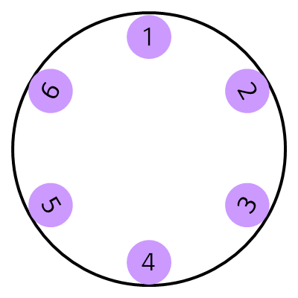
Rotating elements inward / outward
rotate() function
Extends 2d rotation transform function
rotate() = rotate( <angle> | polar-angle | polar-angle-reverse)
transform: rotate(polar-angle);
transform: rotate(polar-angle-reverse);

Slide 12
Several Issues of Polar Positioning
General uses of polar-origin and polar-anchor
polar-anchor vs margin-left & margin-top
pic
Margin for polar-anchor: center

Slide 13
Scrolling in Round Displays
Typical interaction on displays
list item, long texts
Drawbacks
Overflowing
Wasting spaces
This is some text for I want to show you while scrolling .
This is some text for I want to show you while scrolling .
This is some text for I

Slide 14
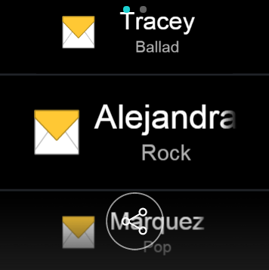
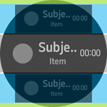
Specify the focused area with pseudo-class
Dynamic scaling and aligning
LG G Watch Urbane, Samsung Gear S2, …
How CSS can do?
Regional pseudo-class
:region( [ center || left || top || right || bottom ]? )
Select elements in specific area
Center
: focusing- scaling, center-aligning
Top, Bottom: fade-out, fade-in

Slide 15
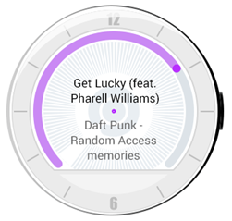

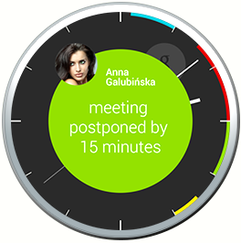
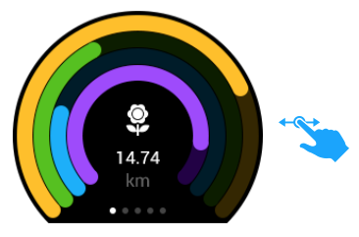
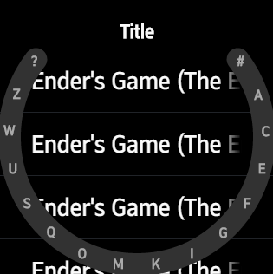
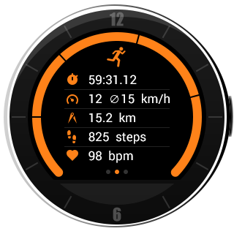
More Requirement for Round Displays
Drawing Arc
How can we draw the arc using CSS?
Animation, Smoothing the end of an arc, …

Slide 16
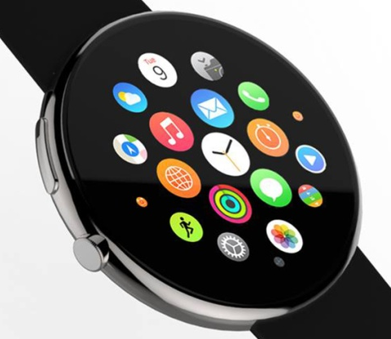
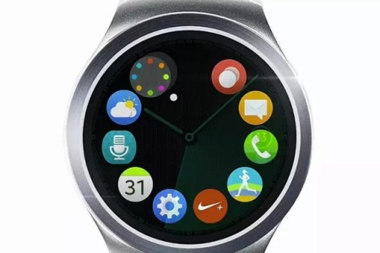
More Requirement for Round Displays
Flexbox Extension
Solution for elements overlapping and overflowing
spiral
[ Samsung Gear S2]
Notes:
http://www.pocket-lint.com/news/130896-the-apple-watch-looks-far-better-with-a-round-face-it-suits-the-ui

Slide 17
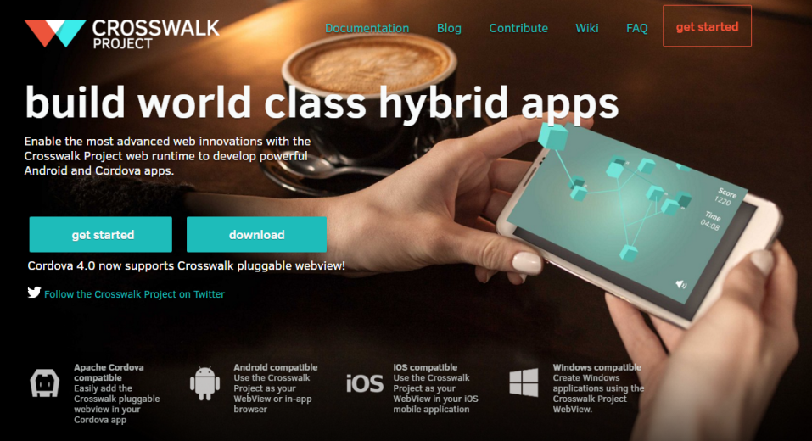
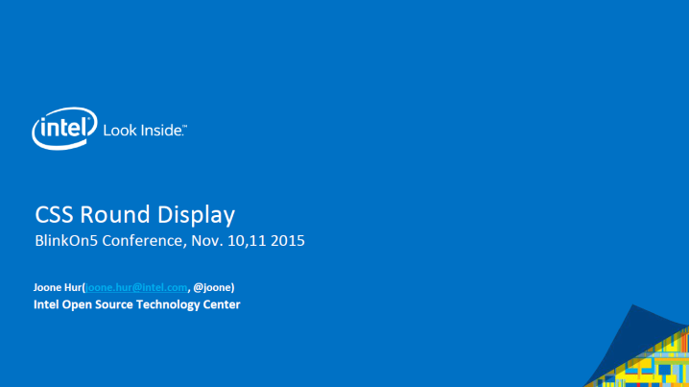
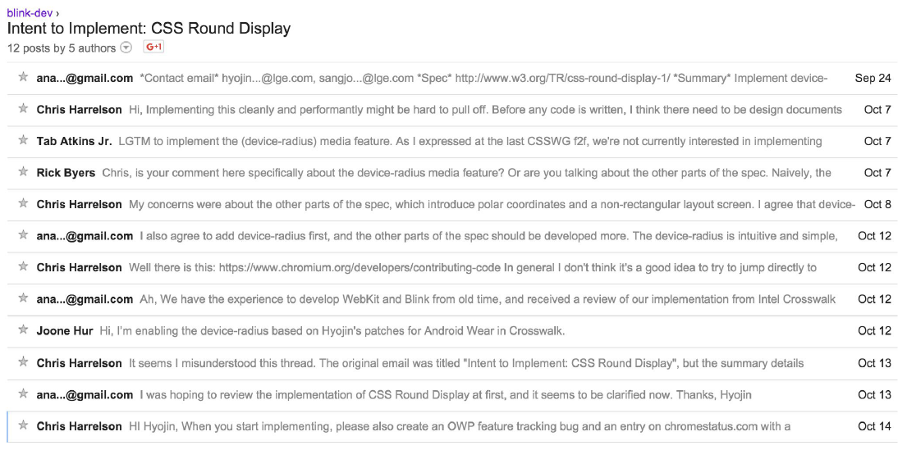
Collaboration with Intel
Crosswalk Project
Hybrid application
Incl. web runtime (blink)
Wearable as a target device
Blink Implementation
Device-radius, border-boundary, polar positioning
BlinkOn5 presentation by Intel (Nov. 11, 2015)
Joint demo in CSS WG Meeting

Slide 18
Conclusion
New display shape(non-rectangular) will ever emerge
CSS Round Display
device-radius / shape-inside: display border-boundary: display / polar positioning
Scrolling in Round Displays
More requirements: arc, flexbox extension
CSS Round Display is open to all web developers

Slide 19
Reference
CSS Round Display Spec
https://drafts.csswg.org/css-round-display/
CSS Round Display Demo (polyfill)
http://anawhj.github.io/jRound/demo/
Alcatel Watch UX
https://medium.com/user-experience-design-1/alcatel-watch-ux-f721a88bff33#.r7vimmr5s
App Design Served
http://www.appdesignserved.co/search?search=android+wear

